Slide 1
Contemporary Bioethical Dilemmas in Dentistry: Patient Autonomy, Medical Necessity and Sustainability
PhD Scientific Days 2025
Supervisor: Prof. Dr. József Kovács PhD Student: Dr. Szilárd Kovács
Mental Health Sciences Division – Doctoral College

Slide 2
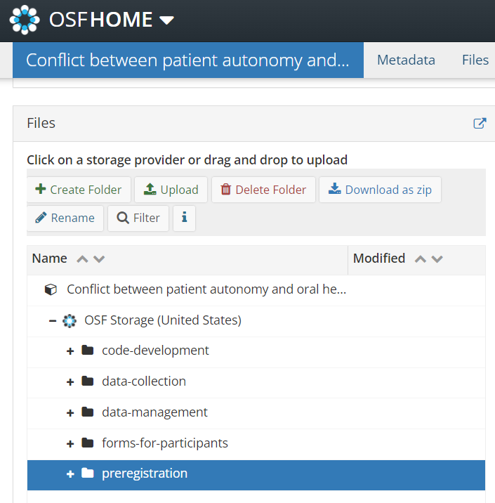


Repositories of my projects
https://doi.org/10.17605/OSF.IO/J8BWZ
https://doi.org/10.17605/OSF.IO/472R6
Preregistration (detailed research plan)
Data collection tools
Data analysis
Open data!!!
Etc.

Slide 3
Definitions: Autonomy and Oral Health
Autonomy: Ability to consider different alternatives and act according to the chosen alternative.
Oral health: „Oral health is multi-faceted and includes the ability to speak, smile, smell, taste, touch, chew, swallow and convey a range of emotions through facial expressions with confidence and without pain, discomfort and disease of the craniofacial complex (head, face, and oral cavity).” (FDI)
Kovács J. 2006. A modern orvosi etika alapjai. Budapest: Medicina Könyvkiadó Zrt.
Glick M, Williams DM, Kleinman DV, et al. 2016. A new definition for oral health developed by the FDI World Dental Federation opens the door to a universal definition of oral health. The Journal of the American Dental Association 147:915–917. https://doi.org/10.1016/j.adaj.2016.10.001

Slide 4
Principlism: The philopsophical framework in bioethics to solve ethical dilemmas with ethical principles
Beauchamp&Childress: “Fundamental principles of biomedical ethics”
Ozar et al.: Central Practive Values of Dentistry
Patient Autonomy
Beneficence
Nonmaleficence
Justice
Not ranked!
Patient’s life and health
Patient’s oral health
Patient autonomy
Dentist’s preferred practice patterns
Esthetic value
Efficiency in resource use

Slide 5

Limitations of patient autonomy in dentistry
The conflict between oral health and patient autonomy in dentistry: a scoping review https://doi.org/10.1186/s12910-024-01156-3
Cases in literature:
Esthetic interventions
Request for tooth extraction for various reasons (fear of comprehensive treatment, rapid solution, mental health disorders, cultural reasons)
Artificial water fluoridation
Forcing oral hygiene practices in nursing home
Literature about the limitations of patient autonomy not in the context of dentistry is exhaustive! See euthanasia, healthy limb amputation in BIID patients, etc.

Slide 6
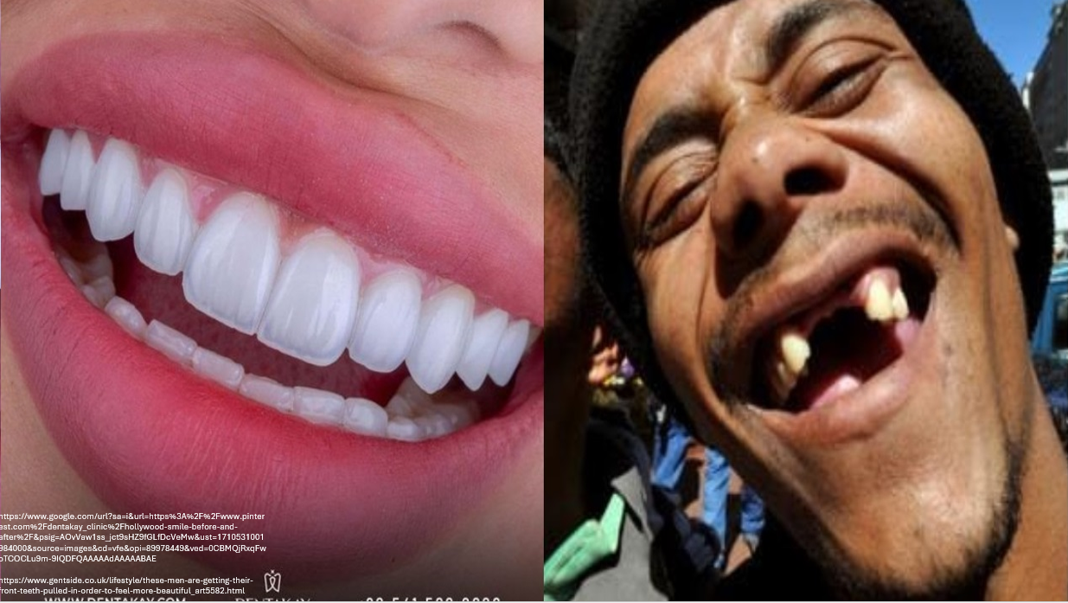

Slide 7
A current issue in medicine (and in dentistry): Sustainability
OECD countries + India + China: 3,3-8,1% of total carbon footprint stems from health care
NHS: Achieve zero net carbon submission by 2040
Public is not aware of healthcare’s role in sustainability, but they support green transformation in medicine when asked
Pichler, Peter-Paul, Ingram S. Jaccard, Ulli Weisz, and Helga Weisz. 2019. International comparison of health care carbon footprints. Environmental Research Letters 14. IOP Publishing: 064004. https://doi.org/10.1088/1748-9326/ab19e1.
Lenzen, Manfred, Arunima Malik, Mengyu Li, Jacob Fry, Helga Weisz, Peter-Paul Pichler, Leonardo Suveges Moreira Chaves, Anthony Capon, and David Pencheon. 2020. The environmental footprint of health care: a global assessment. The Lancet Planetary Health 4: e271–e279. https://doi.org/10.1016/S2542-5196(20)30121-2.
Going green: what do the public think about the NHS and climate change? - The Health Foundation. 2024. https://www.health.org.uk/publications/long-reads/going-green-what-do-the-public-think-about-the-nhs-and-climate-change. Accessed January 4 2024
Liew, K. L., and A. Wilkinson. 2017. P280 How do we choose inhalers? patient and physician perspectives on environmental, financial and ease-of-use factors. Thorax 72. BMJ Publishing Group Ltd: A235–A237. https://doi.org/10.1136/thoraxjnl-2017-210983.422.
D’Ancona, Grainne, Andrew Cumella, Charlotte Renwick, and Samantha Walker. 2021. The sustainability agenda and inhaled therapy: what do patients want? European Respiratory Journal 58. European Respiratory Society. https://doi.org/10.1183/13993003.congress-2021.PA3399.

Slide 8
Richie’s Principles of green medical ethics
Principles of green medical ethics:
Distributive justice
Resource conversation
Simplicity
Ethical economics
+ Green informed consent
Debate: Are green options the duty of policy makers rather the individual medical practitioners?
Richie, Cristina. 2019. Principles of green bioethics: sustainability in health care. East Lansing: Michigan State University Press.
Richie, Cristina. 2023a. “Green informed consent” in the classroom, clinic, and consultation room. Medicine, Health Care and Philosophy 26: 507–515. https://doi.org/10.1007/s11019-023-10163-x.
ten Have, Henk, and Bert Gordijn. 2023. Green bioethics. Medicine, Health Care and Philosophy 26: 497–498. https://doi.org/10.1007/s11019-023-10182-8.

Slide 9
Two ongoing projects
Exploring the conflict between patient autonomy and oral health in dentistry
Environmental sustainability in dental care

Slide 10
Exploring the conflict between patient autonomy and oral health in dentistry: Aims
Research aims: The objective of the study is to explore the ethical dilemma in which the patient’s oral health and autonomy conflict during dental care with the intent to present both dental practitioner and lay perspectives.
Additionally, the study aims to establish the groundwork for further theoretical research to determine ethical guidelines for dentistry.
Research questions:
RQ1: What hierarchy of values do experienced dentists formulate for ethical dental care?
RQ2: How and with the implementation of which principles do experienced dentists act in cases where their patients’ oral health and autonomy conflict?
RQ3: Which hierarchy of values do lay people formulate for ethical dental care?
RQ4: How do lay people make a treatment decision when their oral health and autonomy conflict

Slide 11
Sampling and Data Collection
Two subsamples: Patients (n=14), Dentists (n=10)
Quota for patients: Sex, Age
Quota for dentists: Sex, Leadership experience
Data collection tools:
Semi-structured interview (Topics: Ranking values adopted from literature, Personal experience with the ethical dilemma; Discussing cases adopted from literature: patient request for mass extraction of teeth instead of conservative treatment;)
Sociodemographic survey

Slide 12
Data analysis
Code development: 2 raters conducting guided-inductive coding based on the Central Practice Values; After rounds of triangulation, developing a final codebook
Deductively coding the dataset (after testing IRR)
Epistemic Network Analysis:
Creating code co-occurrence networks for dentists and patients (and subgroups within these)
Visualizing the entire dataset in a projection space

Slide 13
Data analysis
Code development: 2 raters conducting guided-inductive coding based on the Central Practice Values; After rounds of triangulation, developing a final codebook
Deductively coding the dataset (after testing IRR)
Epistemic Network Analysis:
Mean epistemic networks: Code co-occurrence networks for dentists and patients (and subgroups within these)
Projection space: Aggregating epistemic networks of participants and mean networks in a single visualization (locations are significant!)

Slide 14
Code name and label | Central Practice Value | Definition | Example
Well-being | Patient’s life and general health | Physical, mental or social well-being | A treatment outcome boosting the patient’s confidence
Medical indication | Patient’s oral health | Appropriate and pain-free function of the oral cavity and surrounding tissues | Extracting a carious wisdom tooth that could potentially cause further issues
Patient autonomy | Patient autonomy | Treatment decisions made based on patient’s own beliefs, goals, and values; | Patient autonomy
Esthetics | Esthetic values | Esthetic standards of individuals or the wider community | Patient requesting replacing amalgam fillings due to their color
Beneficence | Other (Novel code) | Desire to fulfil “what is in best interest” of the patient; Desire to preserve the patient’s health or bodily integrity | Dentist persuading the patient with an abscess to give consent to a tooth extraction
Professional autonomy | Other (Novel code) | Considering the dentist’s personal set of values, practice patterns; The dentist’s personal responsibilities | Dentist rejecting patient request due to personal convictions
Laws and rules | Other (Novel code) | Choosing a course of action in accordance with the laws governing dental practice; Including reference to quackery | Dentist carrying out a patient request if they sign a form
Feasibility | Other (Novel code) | Weighing the constraints of a desired treatment outcome; What is realistic; What is modern or outdated | Patient acknowledging that modern medicine provides opportunities to treat teeth instead of extracting teeth
Informing | Other (Novel code) | Decision made based on access to information; Informing patients without the intent to convince them; Patient desire to be fully informed | Patient rejecting an intervention based on possible risks outlined by the dentists
Patient comfort | Other (Novel code) | Minimizing the number of sessions, time spent at the dental office, fear (of the treatment, not of dentists in general), or inconvenience prior, during or after the intervention | Patient experiencing emotional distress caused by an intervention
Finance | Other (Novel code) | Decision based on financial considerations | Patient assuming any treatment is possible if one can afford it
Plurality | Other (Novel code) | Acknowledgement of multiple moral systems; Including: Dentist and patient viewpoints, cultural differences | Dentist stating that if they decline a patient’s request, another dentist will likely agree to perform the treatment
Needs | Other (Novel code) | Morality of an intervention differs on the specific circumstance in which it occurs | Dentist fulfilling esthetic requests for a bride’s wedding
Health attitude | Other (Novel code) | Evaluating the feasibility of a treatment based on oral hygiene or regular check-ups | Dentist recommending a different treatment strategy to a patient with insufficient oral hygiene
Prestige | Other (Novel code) | Confidence towards the dentist or medicine as a whole; Public perception of dentistry and medicine | Patient stating that the choice of dentist is a matter of confidence
Triangulation | Other (Novel code) | Weighing others’ opinions | Patient requesting an intervention because it was promoted or undergone by a celebrity
Personal experience | Other (Novel code) | Decisions informed by prior events i where participants were directly involved or had observed others | Patient expressing greater trust in younger dentists after experiencing issues with a filling placed by an older dentist
Minimally invasive | Other (Novel code) | Opting for the alternative that involves less damage to tissues or structures | Dentist prioritizing preventive interventions

Slide 15
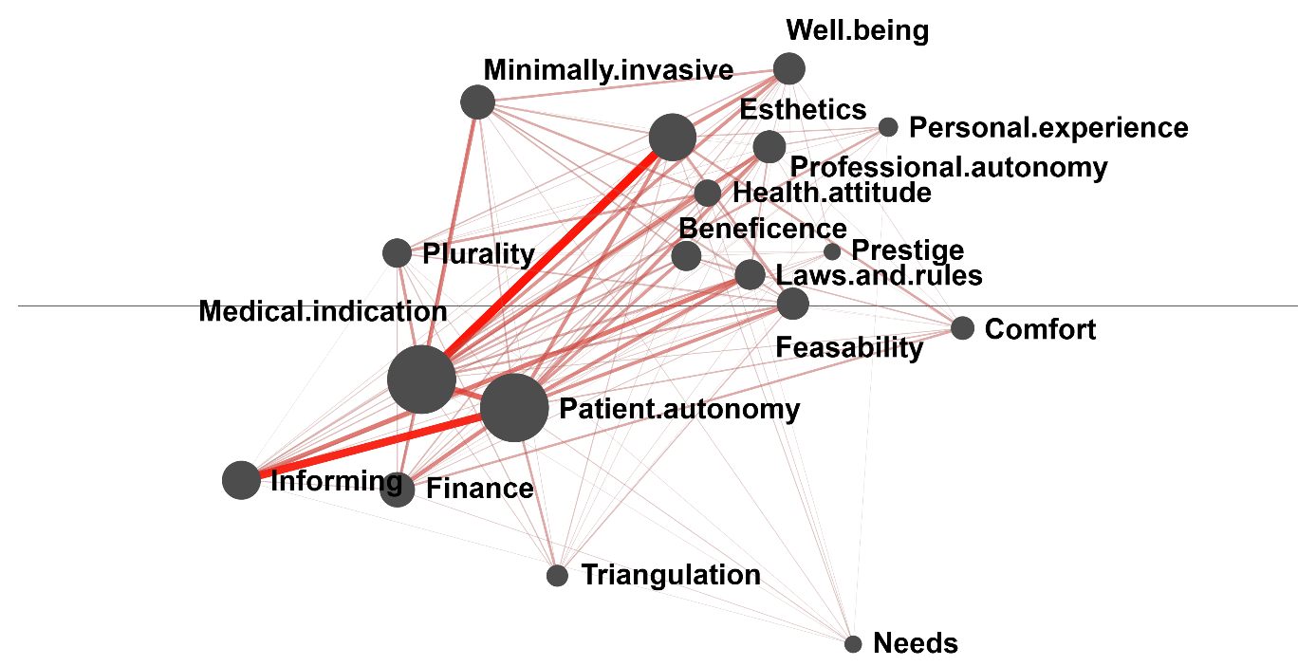
Mean epistemic network of dentists
Nodes represent codes; Node size represents the relative co-occurrence of that code with other codes; Edge thickness and saturations represents the relative frequency of co-occurrence of the given code pair

Slide 16
Mean epistemic network of dentists
Esthetics + Medical indication: Preference for interventions that both satisfy esthetic needs and medical problems
“Az tévedés, az a fogorvos téved, aki azt hiszi, hogy a feladatunk a fogak minél hosszabb ideig szájban tartása. A páciens rágóképességének és esztétikai megjelenések javítása. Márpedig ez kivehető a fogpótlással is végrehajtható.”
Patient autonomy + Inform: Empowering patients to be responsible for their decisions, which become their responsibility
“Neki kell dönteni róla. Én az összes információt elmondom, és válassza ő ki azt, ami neki kedves a szívének is.”

Slide 17
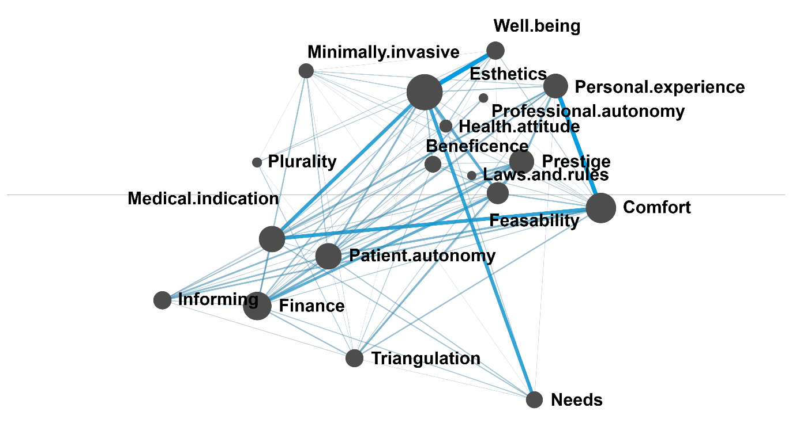
Mean epistemic network of patients
Nodes represent codes; Node size represents the relative co-occurrence of that code with other codes; Edge thickness and saturations represents the relative frequency of co-occurrence of the given code pair

Slide 18
Mean epistemic network of patients
Well-being + Esthetics: Correlation between esthetic appearance and health
“[a szájhigiéné] fontos az esztétika miatt is, meg hát ugye azt gondolom, az egészséges emberek, az egészségnek is az egyik összetevője az, hogy a fogaim is egészségesek.”
Esthetics + Needs: Need for esthetics dependant on a specific life situation
“A tévébe hirdetik is [a fogfehérítést], meg hallottam róla. Hát már ilyen idős korban szerintem nem mindenki megyen. (…) Persze, hogyne, mennék, ha fiatalabb lennék.”

Slide 19
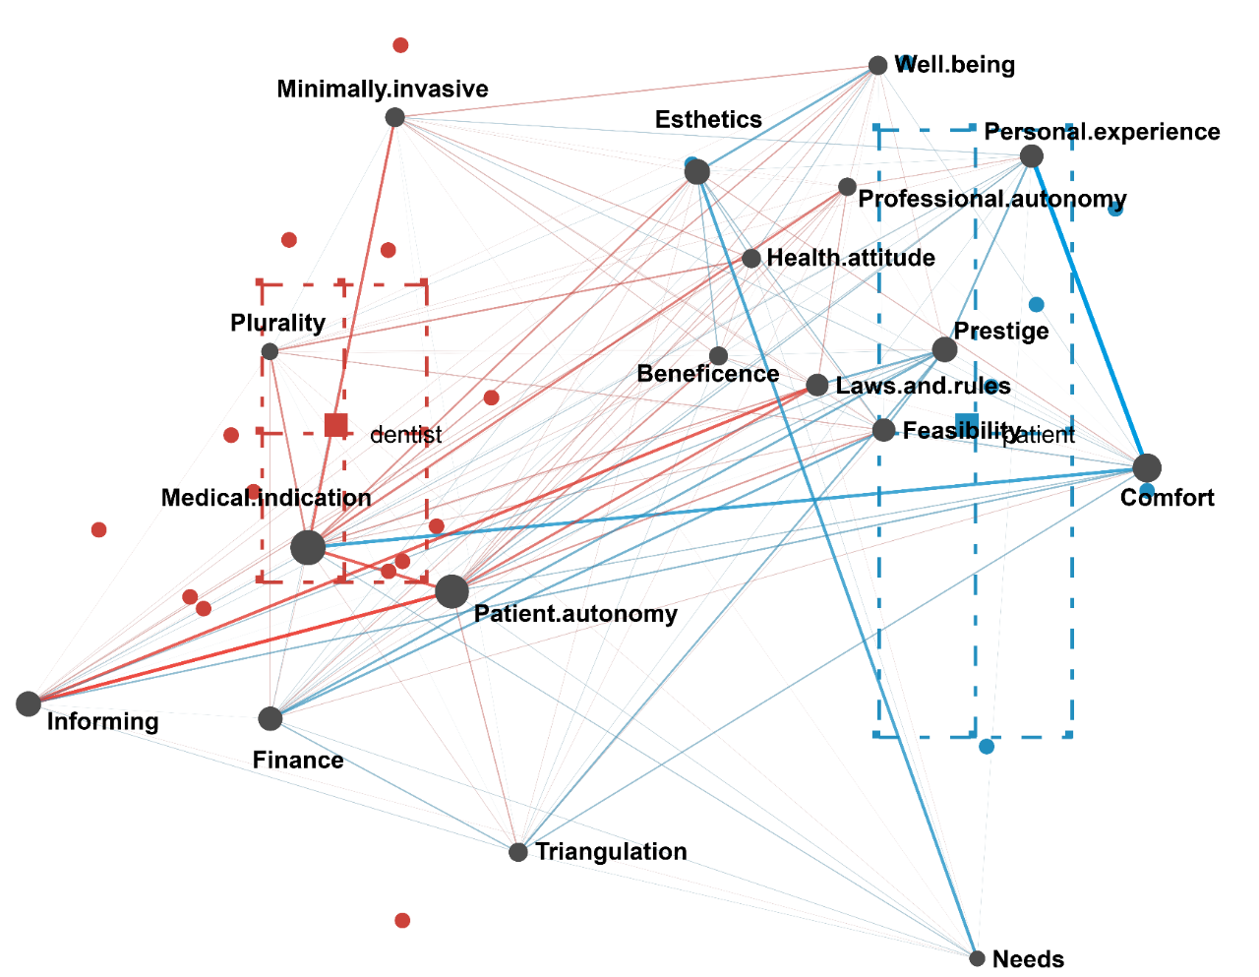
Projection space of dentists and patients
Squares: Mean epistemic networks
Points: Networks of individual participants
Dashed lines: 95% Confidence interval
Red: Dentists
Blue: Patients
Network: Subtracted network of edge weights of mean epistemic networks

Slide 20

Output: Conference presentation about ENA in empirical bioethics with preliminary data
Kovács, S. D. (2024, September 12-14) Pioneering a Novel, Unified, Quantitative- Qualitative Method for Heightened Rigor in Bioethical Dilemmas [Conference presentation]. EACME (European Association of Centres for Medical Ethics) 2024 annual conference, Halle, Germany.

Slide 21
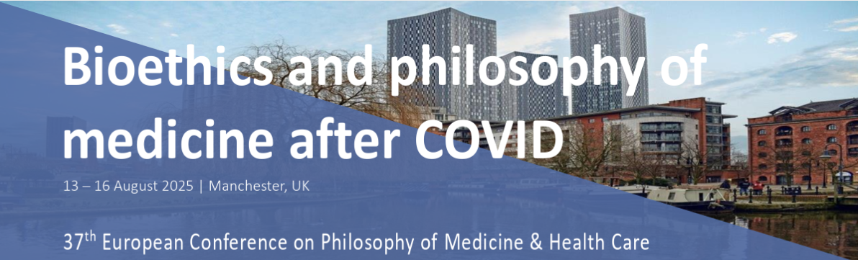
Output: Conference presenation with final data
SD Kovács, Zörgő S. (2025, August 13-16) The conflict between the respect for patient autonomy and oral health in the narratives of Hungarian dentists and patients [Conference presentation]. 37th ESPMH (European Society for Philosophy and Healthcare) Conference, Manchester, UK.

Slide 22
Limitations
The study is explorative and not prescriptive (i.e. what participants report to be ethical should not be accepted as ethical without philosophical evaluation)
The study sample represents the Hungarian context (e.g., in Hungary the vast majority of dental interventions are available “for free” in public care)
Qualitative research: Researcher’s inherent bias when interpreting the data
ENA: Only depicts code PAIRS, not codes in isolation, code triads, code quads, etc.

Slide 23
Patient autonomy in the era of the sustainability crisis
Abstract:
In the realm of medical ethics, the foundational principle of respecting patient autonomy holds significant importance, often emerging as a central concern in numerous ethically complex cases, as authorizing medical assistance in dying or healthy limb amputation on patient request. Even though advocates for either alternative regularly utilize prima facie principles to resolve ethical dilemmas, the interplay between these principles is often the core of the theoretical frameworks. As the ramifications of the sustainability crisis become increasingly evident, there is a growing need to integrate awareness for sustainability into medical decision-making, thus reintroducing potential conflict with patient autonomy. The contention of this study is that the ethical standards established in the 20th century may not adequately address the challenges that have arisen in the 21st century. The author suggests an advanced perception of patient autonomy that prioritizes fostering patients’ knowledge, self-awareness, and sense of responsibility, going beyond a sole focus on their intrinsic values. Empowering patients could serve as a tool to align patient autonomy, beneficence, and the aim to reduce resource consumption.

Slide 24
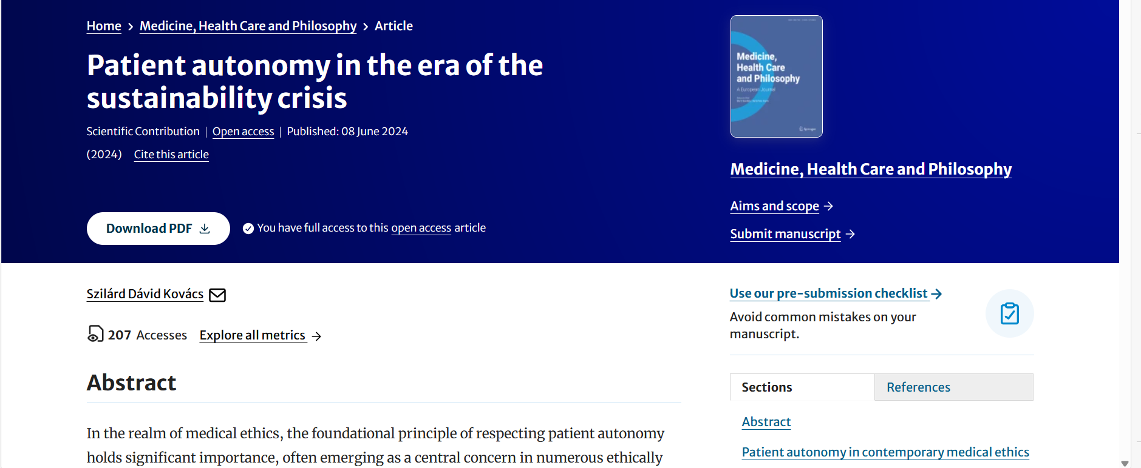
Medicine Health Care and Philosophy (IF: 2,2; D1) https://doi.org/10.1007/s11019-024-10214-x

Slide 25
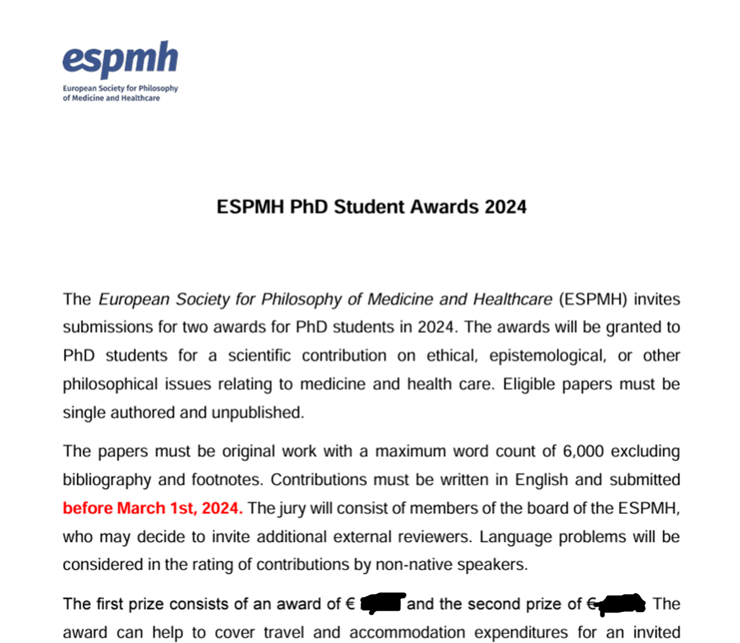

Slide 26
Environmental sustainability in dental care: Exploring current practices and ethical challenges
RQ1: What are the practices of dentists in private and public clinics within the Budapest metropolitan area regarding the adoption of sustainable options? In what ways are dentists’ practices oriented toward:
Reducing waste disposal?
Applying a preventive approach when treating patients?
Applying digital technologies in their practices?
RQ2: How do dentists in private and public clinics in the Budapest metropolitan area perceive their practices related to sustainable alternatives? Namely, how do dentists perceive their efforts in:
Reducing waste disposal in their practices?
Applying a preventive approach when treating patients?
Applying digital technologies in their practices?
RQ3: What barriers do dentists in private and public clinics in the Budapest metropolitan area report as influencing their decisions to adopt more sustainable practices? How do dentists describe the challenges of:
Reducing waste disposal?
Applying a preventive approach when treating patients?
Applying digital technologies in their practices?

Slide 27
Sampling and data collection
Dentists in the Budapest metropolitan area (n=16)
Quotas: Sex, Clinic’s funding (i.e. public or private)
Data collections tools
Structured observations on material use, preventive approach, digital technologies (4 patient treatments per dentist)
Structured interviews self-perceived advancement and limitations in sustainable material, preventive approach, digital technologies
Sociodemographic survey

Slide 28
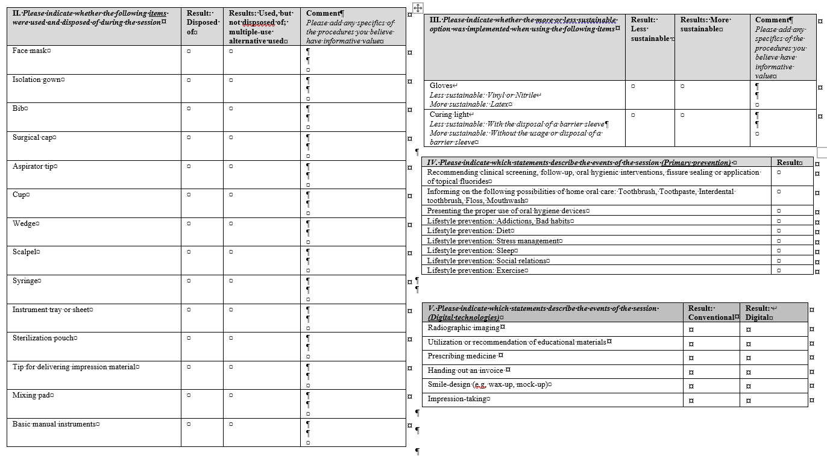

Slide 29
Data analysis
Practices: Observations -> Summary statistics / Sustainability scores
Self-perception on implementing sustainable practices: Coding interview answers on a scale -> Comparing to sustainability scores
Limitations of implementing sustainable practices: Inductive code development by two raters, Triangulation, Establishing a common codebook, Deductively coding dataset, Qualitative Network Approach (network visualization of code co-occurrences by their relationship type [causal, structural, etc.], NOT frequency)

Slide 30
Code name | Code label | Definition | Example
Outdated | [[Outdated]] | Sustainable practices from the past that have been phased out | Dolgoztam régen olyan helyen, ahol üvegpohár volt kitéve a műanyag transzparens pohár helyett, és mindenki hőzöngött, hogy úristen, milyen undorító az egész.
Cost | [[Cost]] | Higher cost for the dentist / dental office; | Hát hogyha lennének olyan lehetőségek, persze megfizethető lehetőségek
Financial support | [[Support]] | Supporting resources for the dentist | szerintem így a finanszírozásnak is nagy szerepe van ebben, legalábbis meglátásom szerint
Patient trust | [[Trust]] | Sustainable practice depending on the patient’s perception of the service provided by the dentist; Including trust and communication | csak itt a páciens oldala kérdőjeles még, hogy mennyire néznék a páciensek jó szemmel, hogy a '80-as évekből üvegpohár van kirakva neki.
Price | [[Price]] | Cost of a dental intervention | Azt mind be kell építeni, akkor a működési költségeidbe beépül az áraidba
Patient motivation | [[Motivation]] | Patients’ lack of compliance towards a sustainable practice; Modeling parental behavior; Lack of care for one’s own health | erre figyelünk, hogyha azt mondom neki, hogy figyeljen rá és menjen el a körzeti orvosához vagy fogorvosához, ahol azzal találkozik, hogy durván elhagyják
Patient education | [[Education]] | Need for patient education on prevention | szerintem kellene kötelezően bevezetni akár biológiaórán, akár így az óvodákban, hogy igenis legyen egy fogorvos, vagy legyen egy dentálhigiénikus,
Infection control | [[Infection]] | Preference of single-use items due to its effectiveness in infection control | Addig, amíg egyszer használatos dolgokkal dolgozunk, és az infekciókontroll nyilván inkább előtérben van, addig ez szerintem nem lesz megoldható.
Availability | [[Available]] | Openness to a sustainable alternative if it becomes available; A sustainable alternative is not available or not known by the dentists | Ha lenne olyan alternatíva, mint például tegyük fel bond ecsetekre, vagy akár az ilyen egyszer használatos, nem tudom műtéti felszerelésekre, akkor nyilván nyitott lennék rá
Efficiency | [[Efficiency]] | Trade-off between sustainability and efficiency; Including not time-efficient, complicated application | Szerintem az idő hiánya, ez a legelső.
Sociodemographic context | [[Socdem]] | A barrier of sustainability applied for certain groups (e.g., age, country) | Főleg az esetleg az idős generációnál ez lehet probléma, mert azt én megfigyeltem, még a pályám elején volt ez gyakoribb
Limited benefit | [[LimBen]] | A sustainable option does not improve dentistry (beyond making it more sustainabile); Including danger for dental staff; | én egyébként nem is tartom annyira átütő jelentőségűnek.
Inertia | [[Inertia]] | Set of moral values or ideology as a barrier of sustainability (e.g., motivation to make more money); Attitude of indifference or inaction toward change | Nem tudom, engem speciel nem érdekel.
Habit | [[Habit]] | Preferring practices that have served well in the past | hogyha ő abban öregszik meg és abban szocializálódik
Quality drop | [[Quality]] | Barrier of sustainability in the inferior quality of providing care; | nekem az elmúlt harminc évben sokkal kevesebb gondom volt a vázakkal, mint például most, amióta lézerszinterezetteket.
Workflow | [[Workflow]] | Aspects of a clinical environment where the possibility of change is recognized | hogyha az asszisztenssel nem szinkronban dolgozunk,
Environment | [[Environment]] | Legal aspects, professional rules, local customs of a dental office unchangeable by the individual dentist | Én úgy gondolom, hogy a szakma szabályai szerint járok el. én jelenleg ugye alkalmazottként vagyok
Personal limitation | [[Personal]] | Personal limitations that prevent the dentist from fully engaging in a more sustainable practice | De hogy ennek mi az akadálya, szerintem az akadálya lehet az a figyelmetlenség

Slide 31
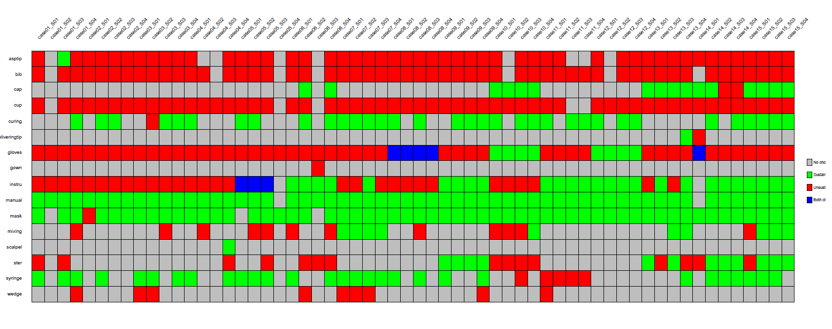
Preliminary results

Slide 32
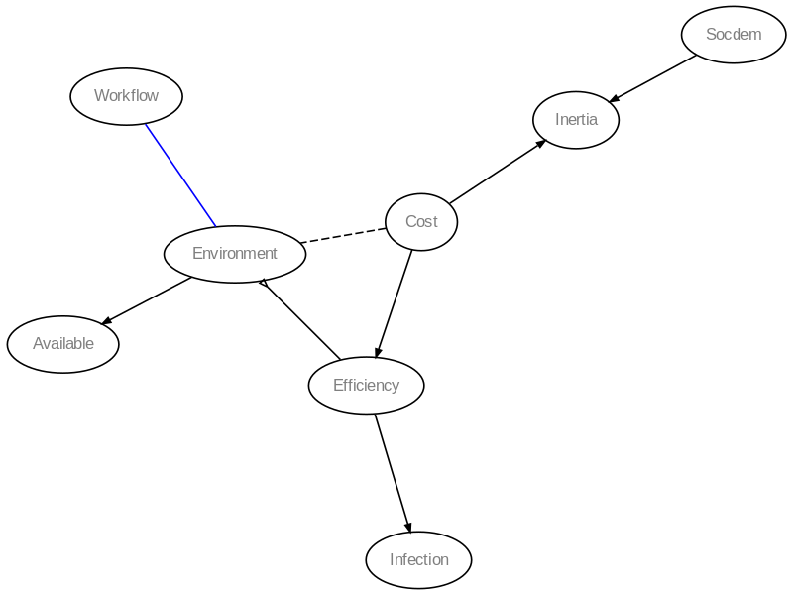
Preliminary results: QNA, case_14

Slide 33
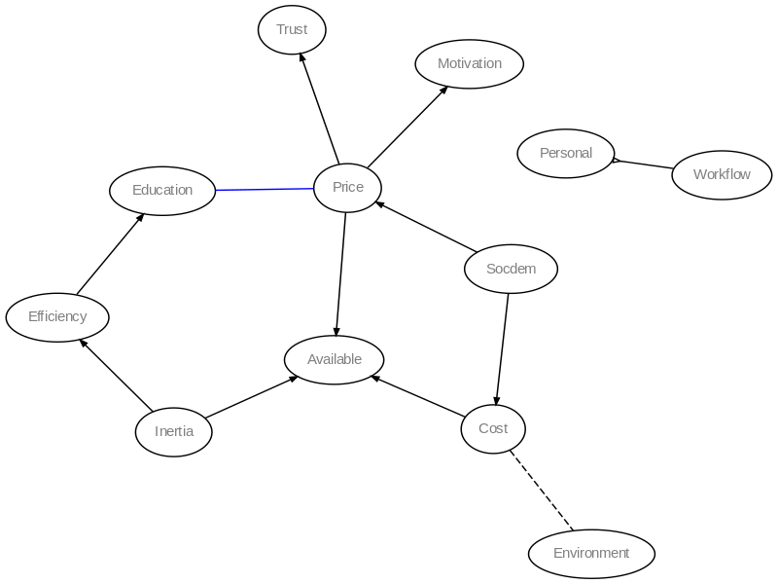
Preliminary results: QNA, Case_15

Slide 34
Limitations
We did not calculate the environmental footprints of the items, but viewed each choice equal
We only examined the sustainability of the dentist-patient interaction (not travel, the building’s energy consumption, etc.)
Preventive approach may not be equally relevant for all patients (e.g., regular patients with excellent oral hygiene)
Dentists’ choices are heavily dependent on what is availability at the clinic
QNA: Does not depict codes in isolation if not paired

Slide 35
Funding
Supported by the EKÖP-2024-2.1.1-EKÖP-2024-00004 University Research Scholarship Programme of the Ministry for Culture and Innovation from the source of the National Research, Development and Innovation Fund

Slide 36
Thank you for your attention!

